Slide 1
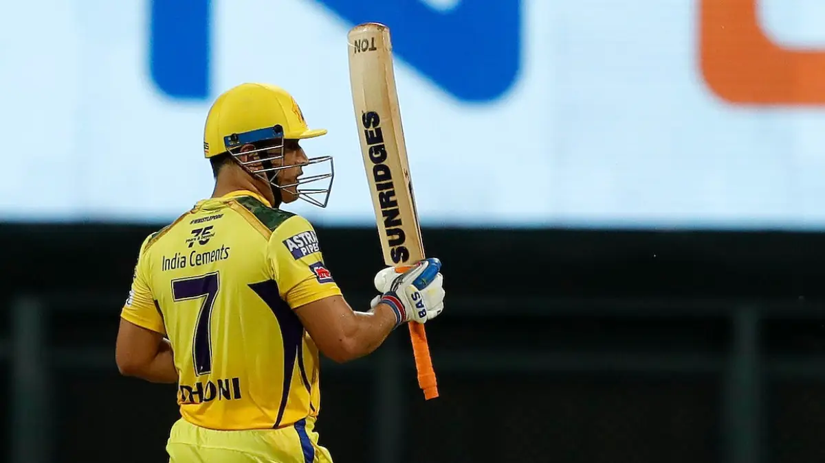
Is Dhoni still good enough to bat?
By Arunkumar S

Slide 2
Introduction:
Mahendra Singh Dhoni, the former Indian Captain who is fondly known as “Thala” all over the India is one of the greatest players that the World Cricket has ever seen. He is the one of the most successful captains in IPL history with 4 trophies to his name. The way he handles the pressure in toughest of situations makes him an invaluable player in any format that he plays. With all the due respect to the GOAT player of cricket , In this Analysis we will come to a conclusion whether he is still able to bat in the shortest format of the game in the form of IPL.

Slide 3
Data Source and Tools Used:
Data sources:
Cricsheet.org [ IPL ball by ball data from 2008 to 2022 ]
Iplt20.com
Tool used:
Jupyter Notebook for Data Analysis
Power BI for Visualisation

Slide 4
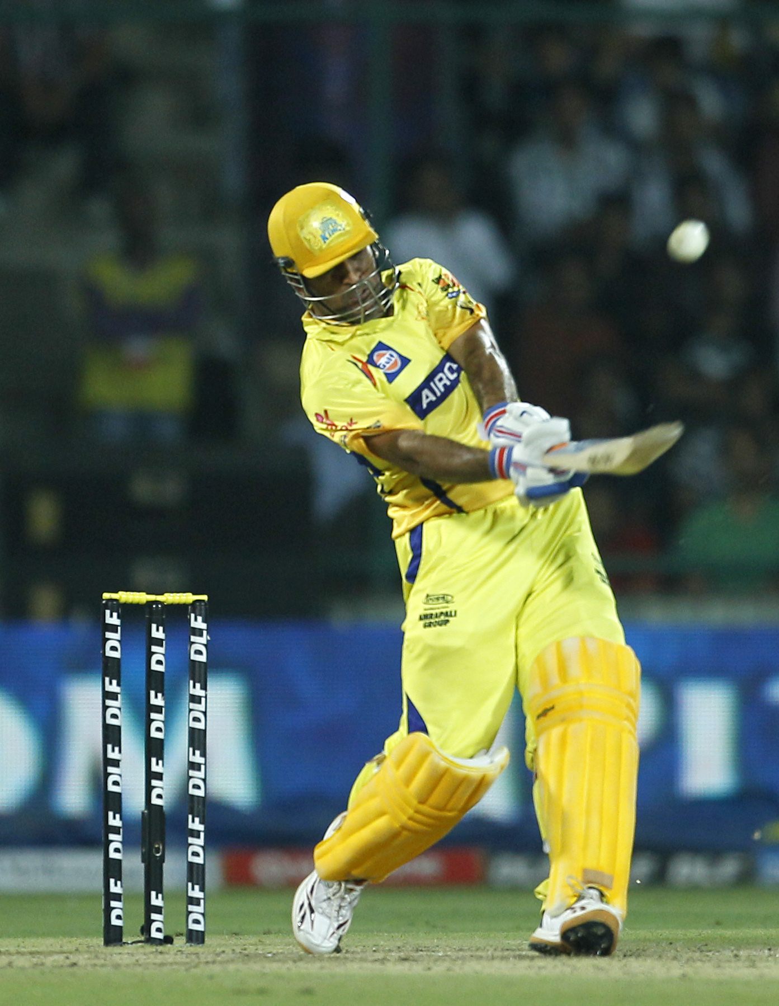
Overall IPL career stats:
Matches : 234
Runs : 4978
Strike Rate : 135.20
Average : 39.20
4’s | 6’s : 346 | 229
30 plus scores : 64
High Score : 84

Slide 5
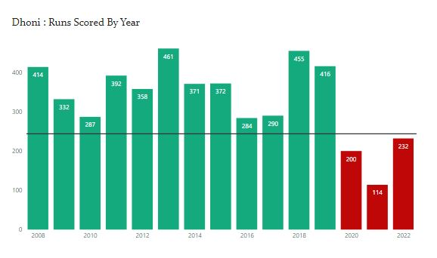
Runs scored over the years:
After the retirement from international cricket in 2019, Dhoni’s run scoring capability has come under the radar. From the graph, it is quite evident that he struggles to score with the bat with 3 consecutive below par season with less than 250 runs.

Slide 6
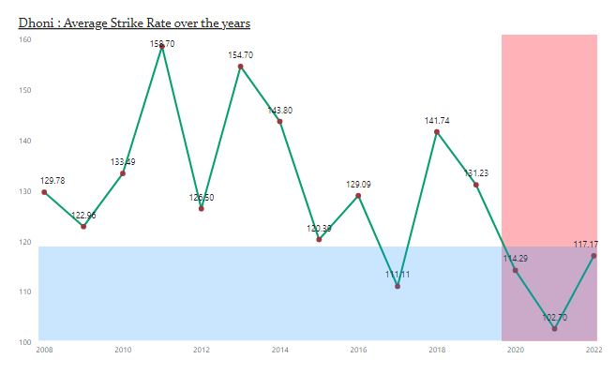
Strike rate concern:
Strike rate has been the talking point in T20 cricket for some time now. Being a finisher, over the years his strike rate has been phenomenal with highest strike rate in 2011. But in the last 3 years, his strike rate falls below 120 which is way low for a finisher in this format.

Slide 7
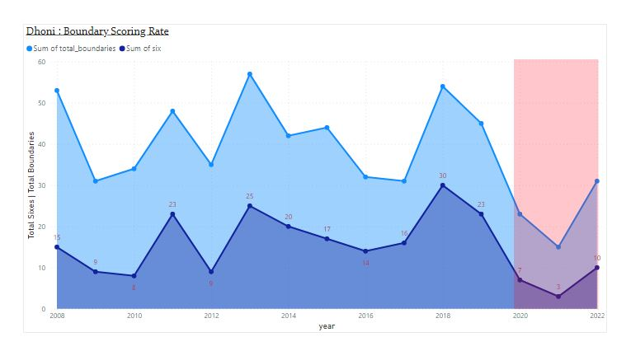
BOUNDARY SCORING:
Finisher’s role in today’s cricket is to maximize the score at the death by scoring as many boundaries as possible. Arguably the greatest finishers of all time ,Dhoni has mastered this art in the past. But in past 3 seasons, he failed to carry that reputation.

Slide 8
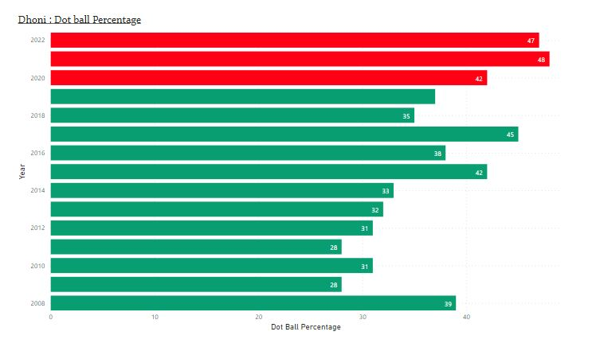
Dot balls faced:
The dot balls percentage around 48% in the past 2 seasons shows that he is unable to rotate the strike like he done in the past. He always a plays some amount of dot balls to get set and launch in the end. But in past 2 seasons, his boundary scoring rate has already been low which means that this dot balls put pressure on batter at other end.

Slide 9
CONCLUSION:
From the above Analysis, it is quite evident that he struggles to score runs with good strike rate post his retirement from International cricket. Being a Finisher, his boundary scoring rate also starts to reduce and at the same time, the dot balls that he faced starts to increase. This means that he is putting extra pressure on the batter at other end. He was the greatest finisher that world cricket has ever saw but with aging and lack of game practice shows a dip in his batting ability.
Dhoni the captain, is still the master without any argument but Now its fair to say that Dhoni the batter is no longer the same which we used to saw back in 2019 or before.

